Slide 1
Space Code

Slide 2


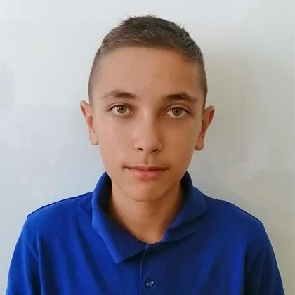


Our Team
Yavor Pennkov
Scrum trainer
Gabriel Yanchev
Front-End
Miroslav Chobanov
Back-end
Lubo Dimov
Back-end
Maxim Mateev
Back-end

Slide 3
About the project
Answering questions about online education involves providing comprehensive and informative responses that address learners' inquiries regarding various aspects of digital learning. Educators and experts in the field strive to offer accurate information, practical advice, and resources to support students navigating online learning platforms, instructional methods, technological tools, and academic challenges. By addressing queries effectively, they empower learners to make informed decisions, enhance their learning experiences, and achieve their educational goals in the online environment.

Slide 4







Used Technologies

Slide 5
Now let's jump to the project!

